Slide 1
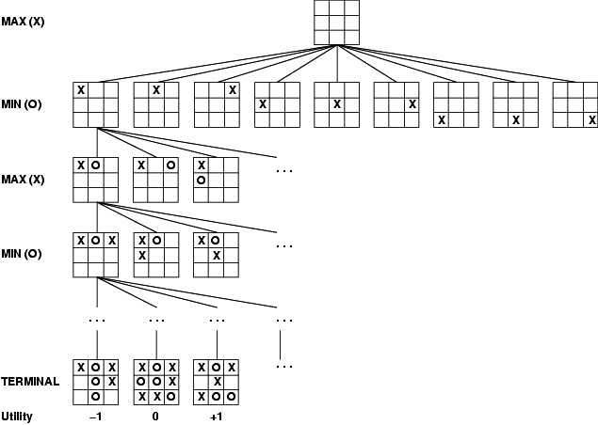
Backtracking by
Greg

Slide 2
Backtracking
Suppose you have to make a series of decisions, among various choices, but…
  You don’t have enough information to know what decision to choose
  Each decision leads to a new set of choices
  Some sequence of choices (possibly more than one) may be a solution to your problem
Backtracking is a methodical way of trying out various sequences of decisions, until you find one that “works”
KB 2 - Backtracking

Slide 3
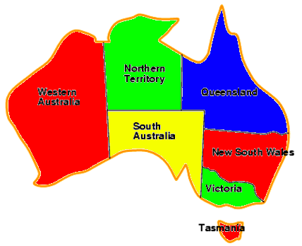
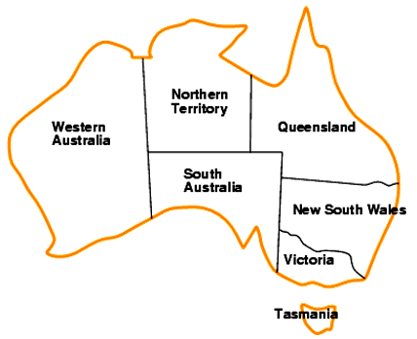
Coloring a Map
You wish to color a map with
not more than four colors
  red, yellow, green, blue
Adjacent countries must be in
different colors
You don’t have enough informa-
tion to choose colors
Each choice leads to another
set of choices
One or more sequences of choices
may (or may not) lead to a solution
Many coloring problems can be solved with backtracking
KB 2 - Backtracking

Slide 4
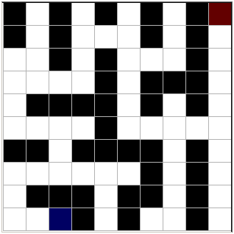
Solving a Maze
Given a maze, find a path from start to finish
At each intersection, you have to decide between three or fewer choices:
  Go straight
  Go left
  Go right
You don’t have enough information to choose correctly
Each choice leads to another set of choices
One or more sequences of choices may (or may not) lead to a solution
Many types of maze problem can be solved with backtracking
KB 2 - Backtracking

Slide 5

Knight’s Tour Problem
In the game of chess, a knight can move from a given square to one of at most eight other positions, as indicated in picture.
Knight’s Tour Problem:
Is it possible for a knight to start on some square of the chessboard and make a sequence of 63 moves in such a way that it visits every square exactly once?
 |  |  | 8 |  | 1
 |  | 7 |  |  |  | 2
 |  | 6 |  |  |  | 3
 |  |  | 5 |  | 4
KB 2 - Backtracking

Slide 6

N-Queens Problem
N-Queens Problem :
Shows that a maximum of N-Queens can be placed on N x N Chessboard in such manner that no queen can be taken by any other!
KB 2 - Backtracking

Slide 7
Backtracking (animation)
dead end
?
dead end
dead end
?
start
?
?
dead end
dead end
?
Found It!!!
KB 2 - Backtracking

Slide 8
Tree Terminology I
A tree is composed of nodes
There are three kinds of nodes:
The (one) root node
Internal nodes
Backtracking can be thought of as searching a tree for a particular “goal” leaf node
Leaf nodes
KB 2 - Backtracking

Slide 9
Tree Terminology II
Each non-leaf node in a tree is a parent of one or more other nodes (its children)
Each node in the tree, other than the root, has exactly one parent
parent
Usually, however, we draw our trees downward, with the root at the top
parent
children
children
KB 2 - Backtracking

Slide 10
Real and Virtual Trees
There is a type of data structure called a tree
  But we aren’t using it here!!!
If we diagram the sequence of choices we make, the diagram looks like a tree
  Our Backtracking algorithm “sweeps out a virtual tree” in “problem space”
KB 2 - Backtracking

Slide 11
The Backtrack Algorithm
Backtracking is really quite simple —> we “explore” each node, as follows:
To “explore” node N:
Explore(N) // Backtrack algorithm
Step 1: If N is a leaf node,
Step 2: If N is a goal node
Step 3: Return “success”
Step 4: For each child C of N,
Step 5: Explore (C)
Step 6: If C was successful
Step 7: Return “success”
Step 8: Return “failure”
KB 2 - Backtracking

Slide 12
Full example: Map coloring
The Four Color Theorem states that any map on a plane can be colored with no more than four colors, so that no two countries with a common border are the same color
  For most maps, finding a legal coloring is easy
  For some maps, it can be fairly difficult to find a legal coloring
We will develop a complete C/C++ program to solve this problem
MapColoringProblem\Debug\MapColoringProblem.exe
KB 2 - Backtracking

Slide 13
Data Structures
We need a data structure that is easy to work with, and supports:
  Setting a color for each country
  For each country, finding all adjacent countries
We can do this with two arrays
  An array of “colors”, where countryColor[i] is the color of the i^{th} country
  A ragged array of adjacent countries, where map[i][j] is the j^{th} country adjacent to country i
    Example: map[5][3]==8 means the 3th country adjacent to country 5 is country 8
KB 2 - Backtracking

Slide 14
Creating The Map
0
1
int map[7][5] = {{ 1, 4, 2, 5,-1 },
{ 0, 4, 6, 5,-1 },
{ 0, 4, 3, 6, 5 },
{ 2, 4, 6,-1,-1 },
{ 0, 1, 6, 3, 2 },
{ 2, 6, 1, 0,-1 },
{ 2, 3, 4, 1, 5 }};
4
2
3
6
5
KB 2 - Backtracking

Slide 15
Setting the initial colors
Assume:
0 = White 1 = Red 2 = Yellow
3 = Green 4 = Blue
int mapColors[7] = { 0, 0, 0, 0, 0, 0, 0 };
KB 2 - Backtracking

Slide 16
The Main Program
bool explore(int, int);
bool okToColor(int , int);
void printMap();
void main()
{ bool result = explore(0, 1);
if(result)
cout << "Berhasil!!!\n";
else
cout << "Gagal!!!\n";
printMap();
}
KB 2 - Backtracking

Slide 17
The BackTracking Function
bool explore(int country, int color)
{ if (country >= 7)
  return true;
  if (okToColor(country, color)) {
    mapColors[country] = color;
for (int i = 1; i <= 4; i++) {
if (explore(country + 1, i))
return true;
}
}
return false;
}
KB 2 - Backtracking

Slide 18
Checking if a color can be used
bool okToColor(int country, int color)
{ int iAdjCountry;
for (int i = 0; i < 5; i++) {
if(map[country][i] != -1)
iAdjCountry = map[country][i];
if (mapColors[iAdjCountry] == color)
return false;
}
return true;
}
KB 2 - Backtracking

Slide 19
Printing the results
void printMap() {
for (int i = 0; i < 7; i++) {
cout << "map[" << i << "] berwarna ";
switch (mapColors[i]) {
case 0: cout << "Putih"; break;
case 1: cout << "Merah"; break;
case 2: cout << "Kuning"; break;
case 3: cout << "Hijau"; break;
case 4: cout << "Biru"; break;
}
cout << "\n";
}
}
KB 2 - Backtracking

Slide 20
Recapture problem
0
1
We went through all the countries recursively, starting with country zero
At each country we had to decide a color
  It had to be different from all adjacent countries
  If we could not find a legal color, we reported failure
  If we could find a color, we used it and recurred with the next country
  If we ran out of countries (colored them all), we reported success
When we returned from the topmost call, we were done
4
2
3
6
5
KB 2 - Backtracking

Slide 21
Visualizations
Map Coloring Problem
Program Visualisasi\Map Coloring 1.1
Solving Maze
Program Visualisasi\Solving Maze 0.8
Knight’s Tour Problem
Program Visualisasi\Knight Tour 1.2
N-Queens Problem
Program Visualisasi\N-Queen 1.0
KB 2 - Backtracking

